Slide 1
Introduction to Computer Vision and Object Detection

Slide 2
Outlines
Computer Vision Tasks
Object Detection
Object Detection Approaches
Accuracy Measurements
Introduction To OpenCV

Slide 3
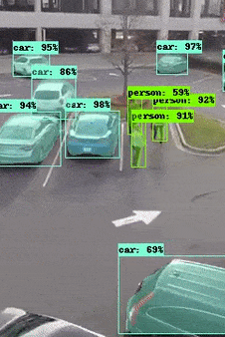
What is Computer Vision ?
Think of CV as the digital equivalent of the eyes and the visual cortex of the brain.
Computer Vision has various applications such
as image recognition, object detection, facial
recognition, and more.
CV systems learn through exposure to massive amounts of image data, enabling them to identify objects, scenes, and even complex actions.

Slide 4

Computer Vision Tasks

Slide 5
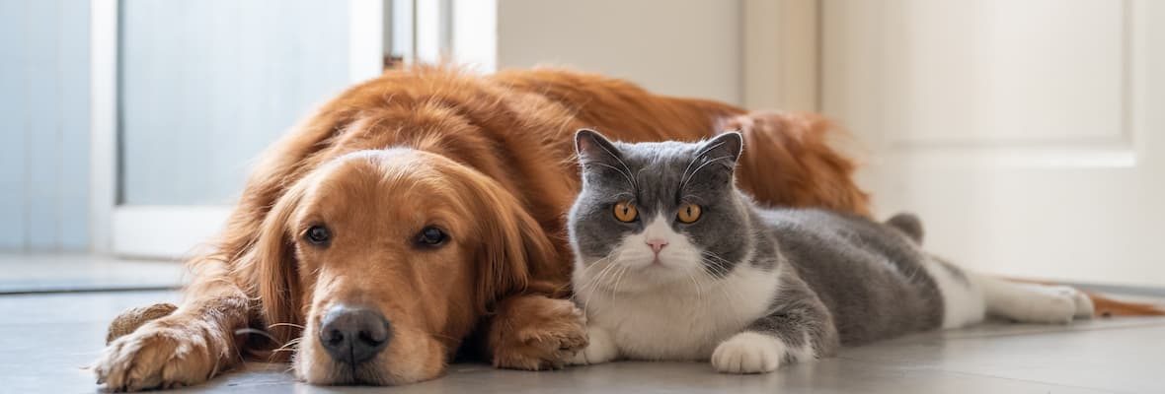
Classification
Dog & Cat

Slide 6
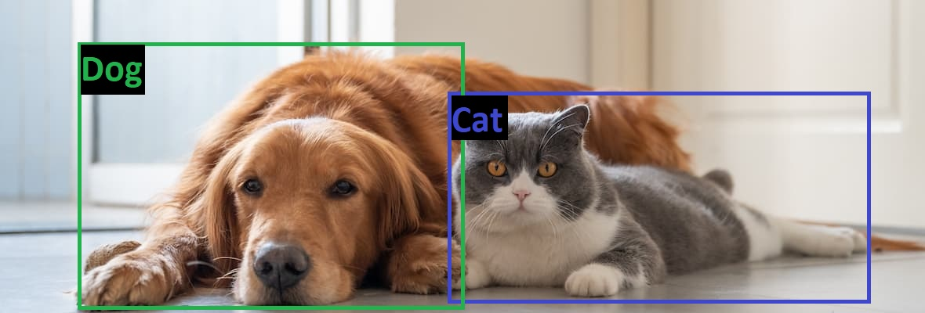
Object Detection
Dog & Cat
+
Coordinates

Slide 7
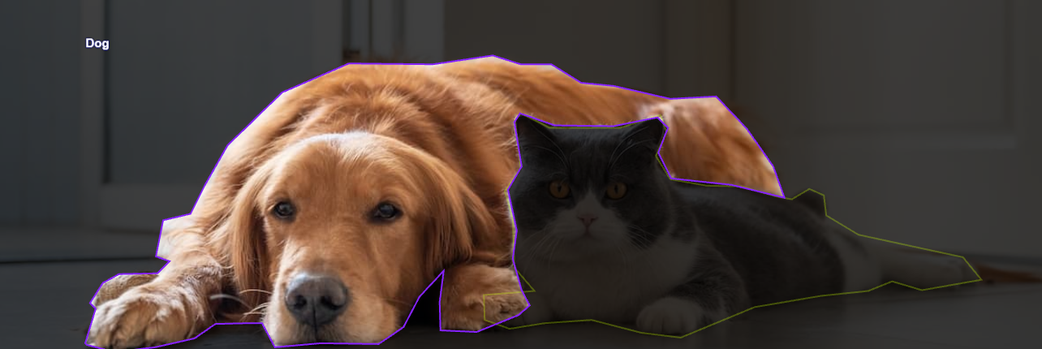
Object Segmentation
Segmented Dog

Slide 8
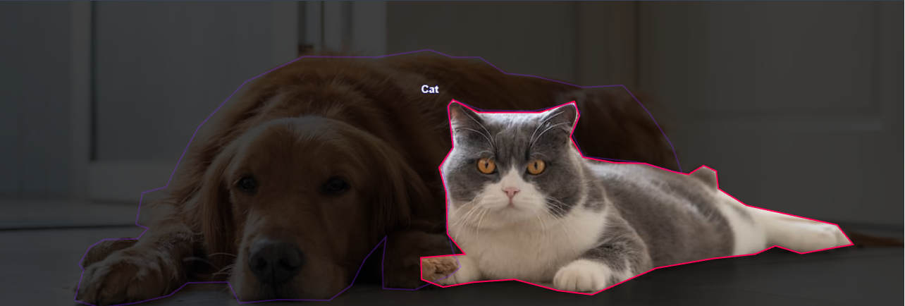
Object Segmentation
Segmented Cat

Slide 9
What is Object Detection?
Object
Classification
Object
Localization
Repeat For Other
Objects in The Image

Slide 10
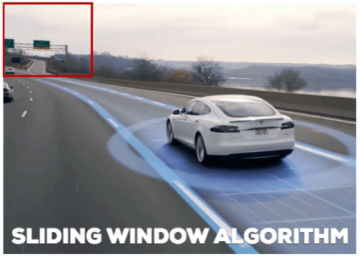
Object Detection Approaches
Sliding Window

Slide 11
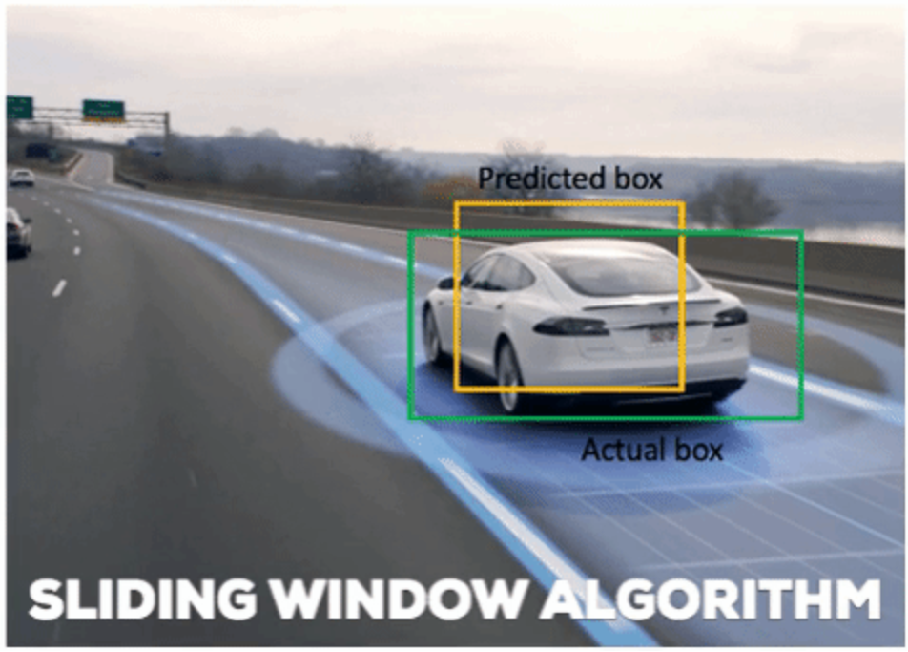
Object Detection Approaches
Sliding Window

Slide 12
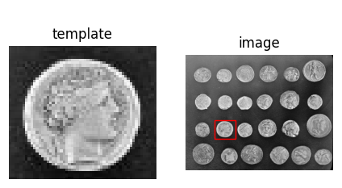
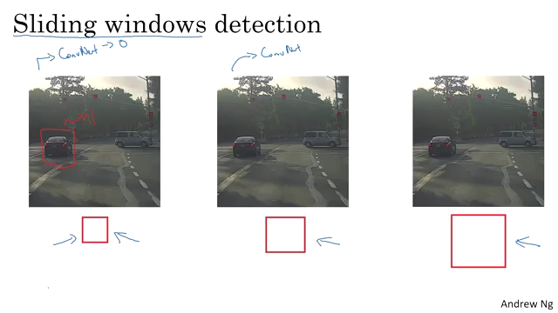
Sliding Window
How does it work ?!
Template-based
2. Trained Neural Network

Slide 13
Sliding Window
Limitations
Computational Cost:
Sliding the window across the entire image.
Accuracy and Efficiency
Window Size and Stride.

Slide 14
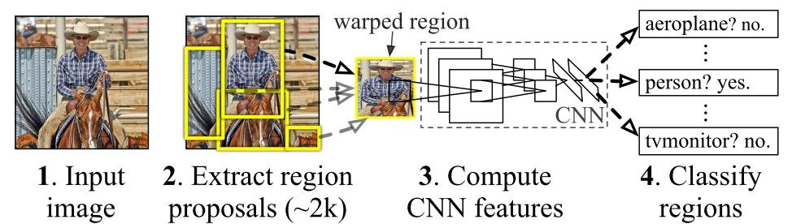
Object Detection Approaches
R-CNN

Slide 15
R-CNN
Limitations
Still computationally expensive:
Two-stage approach: “proposal generation” and “classification”.
Can’t make real-time detections.
For real-time applications, newer architectures like Faster R-CNN might be better choices.

Slide 16
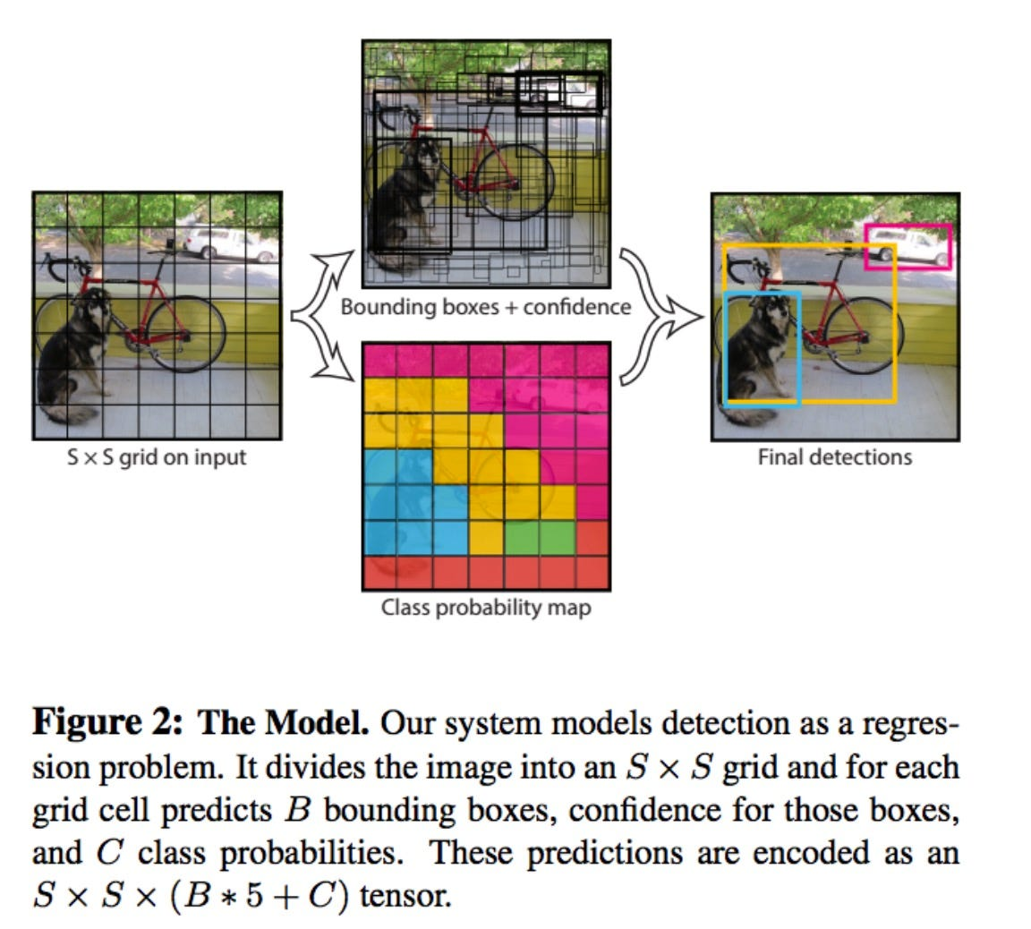
Object Detection Approaches
YOLO Algorithm

Slide 17
YOLO –You Only Look Once-
Limitations
It could have Lower Accuracy and less precise localization than the newest "Faster R-CNN" architectures.
But the latest YOLO architectures, such as "YOLOv8" and "YOLOv9" outperform "Faster R-CNN" in terms of speed and accuracy.

Slide 18
Object Detection Accuracy Measurements

Slide 19
IoU: Intersection Over Union

Slide 20
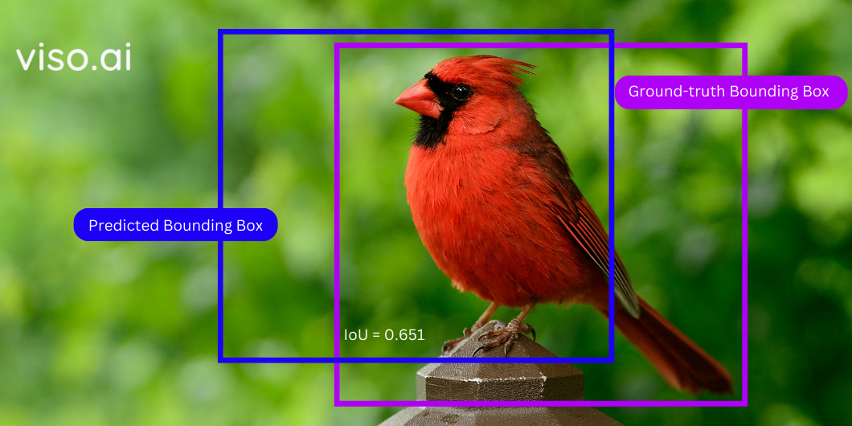
IoU: Intersection Over Union
Measures the overlap between the predicted bounding box and the ground truth bounding box

Slide 21
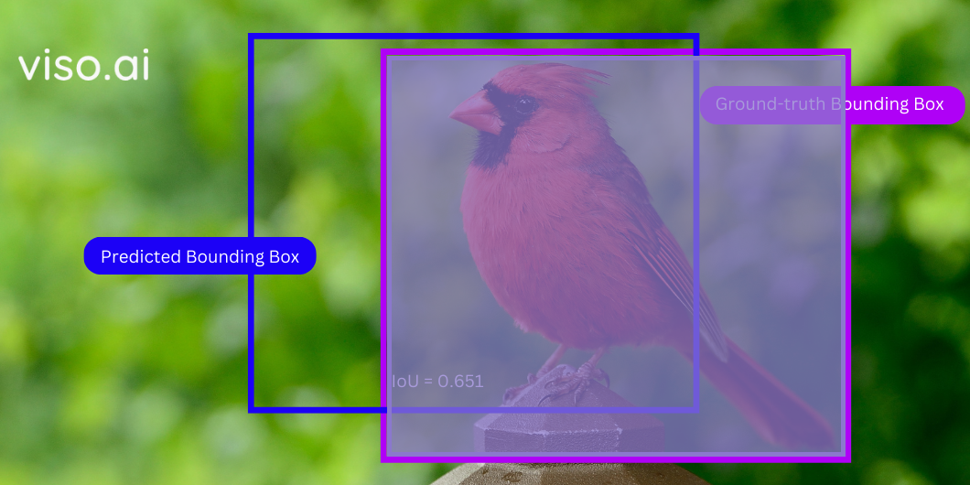
IoU: Intersection Over Union
Measures the overlap between the predicted bounding box and the ground truth bounding box

Slide 22
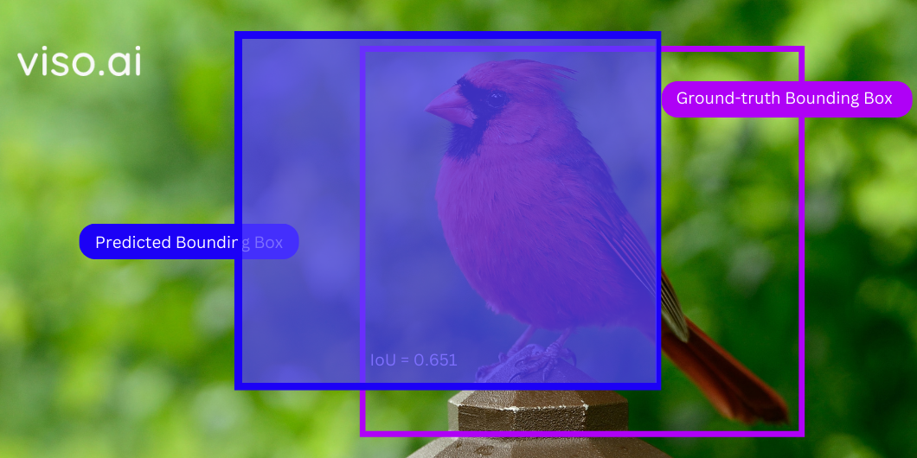
IoU: Intersection Over Union
Measures the overlap between the predicted bounding box and the ground truth bounding box

Slide 23
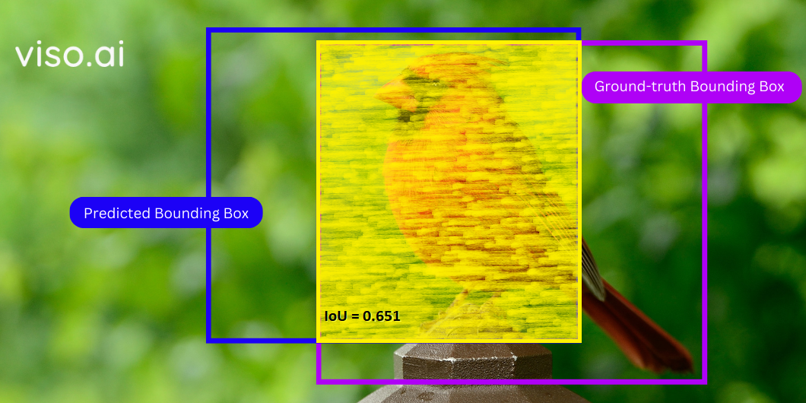
IoU: Intersection Over Union
Measures the overlap between the predicted bounding box and the ground truth bounding box

Slide 24
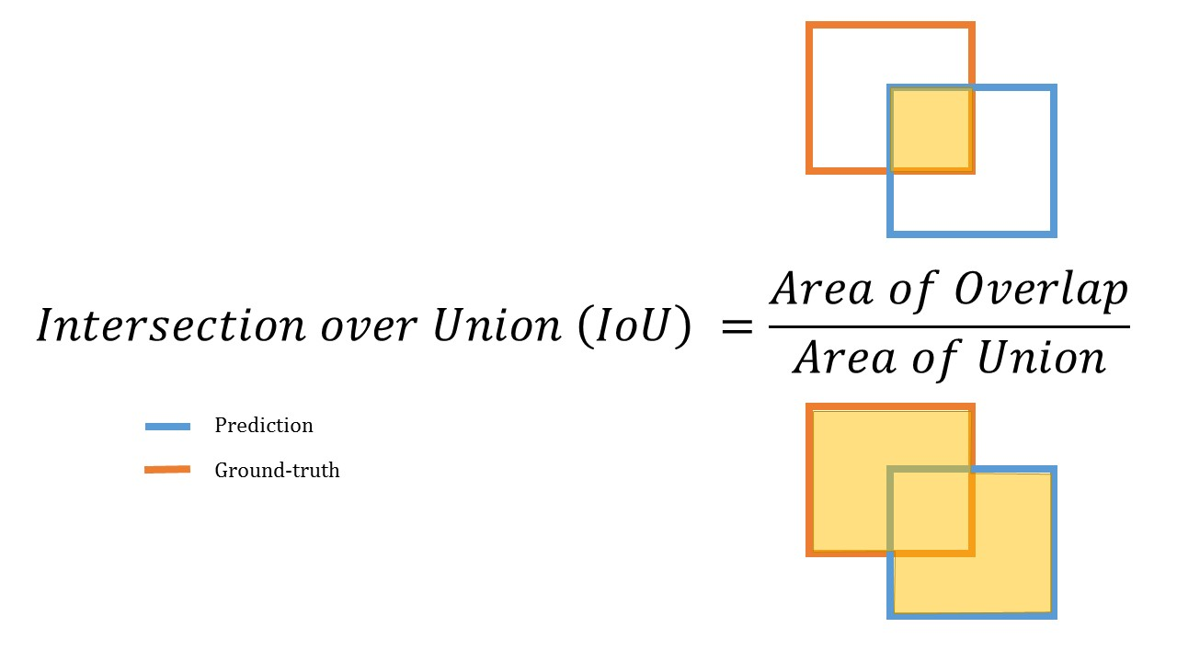
IoU: Intersection Over Union
Measures the overlap between the predicted bounding box and the ground truth bounding box

Slide 25
Non-Max Suppression

Slide 26
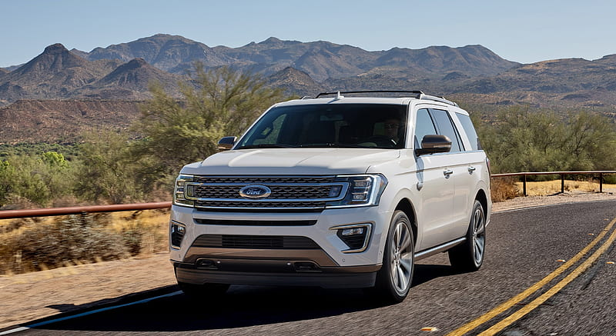
Non max Suppression
A technique used in object detection to remove redundant bounding boxes of the same class. It keeps only the most confident bounding boxes and those with the least overlap with the others.

Slide 27
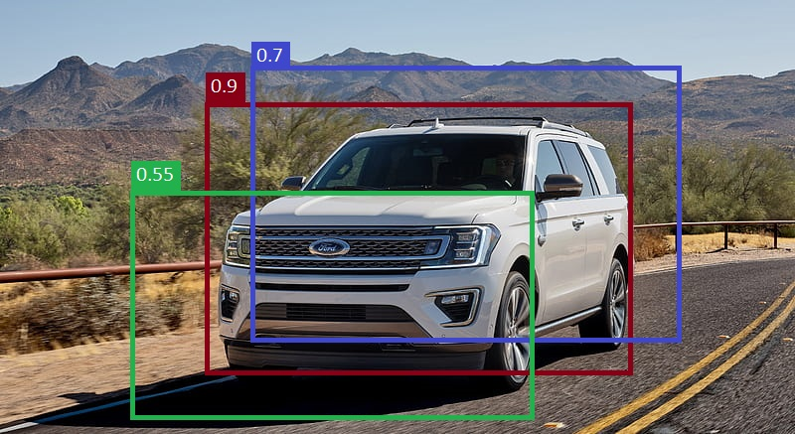
Non max Suppression
A technique used in object detection to remove redundant bounding boxes of the same class. It keeps only the most confident bounding boxes and those with the least overlap with the others.

Slide 28
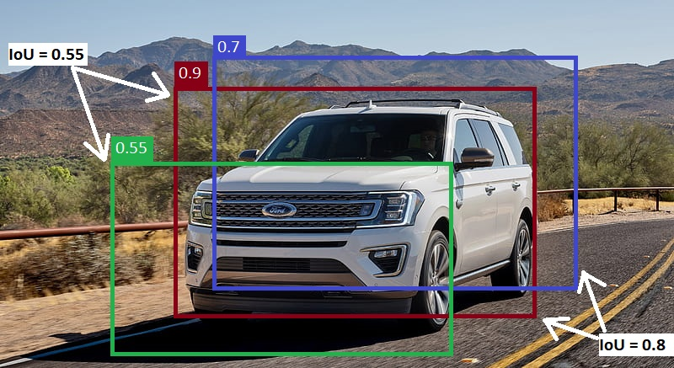
Non max Suppression
A technique used in object detection to remove redundant bounding boxes of the same class. It keeps only the most confident bounding boxes and those with the least overlap with the others.
IoU Threshold = 0.5
If IoU > 0.5 then:
Discard the box
Else:
Keep it

Slide 29
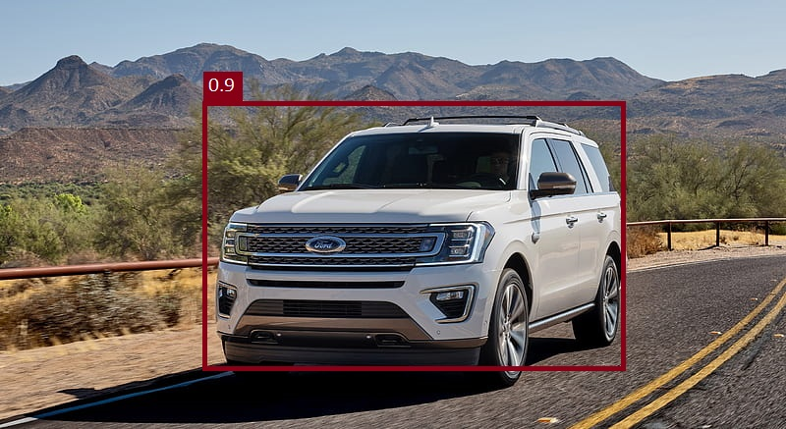
Non max Suppression
A technique used in object detection to remove redundant bounding boxes of the same class. It keeps only the most confident bounding boxes and those with the least overlap with the others.

Slide 30
mAP: Mean Average Precision

Slide 31
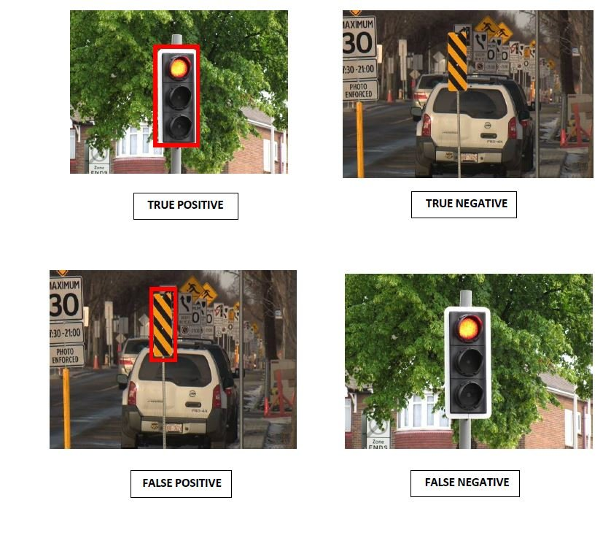
Mean Average Precision
This metric considers both the precision and recall for different IoU thresholds, A higher mAP indicates better overall localization performance across various confidence levels.

Slide 32
Mean Average Precision
Calculate the precision and recall metrics.
Calculate the area under the precision-recall curve to get AP for a certain class.
mAP: The average of all classes' APs.
For Example:
mAP@0.5:0.05:0.95 = 0.87
That means the mAP for this three thresholds:
“0.5” + ”0.05” + “0.95” = 0.87

Slide 33
Open-CV

Slide 34
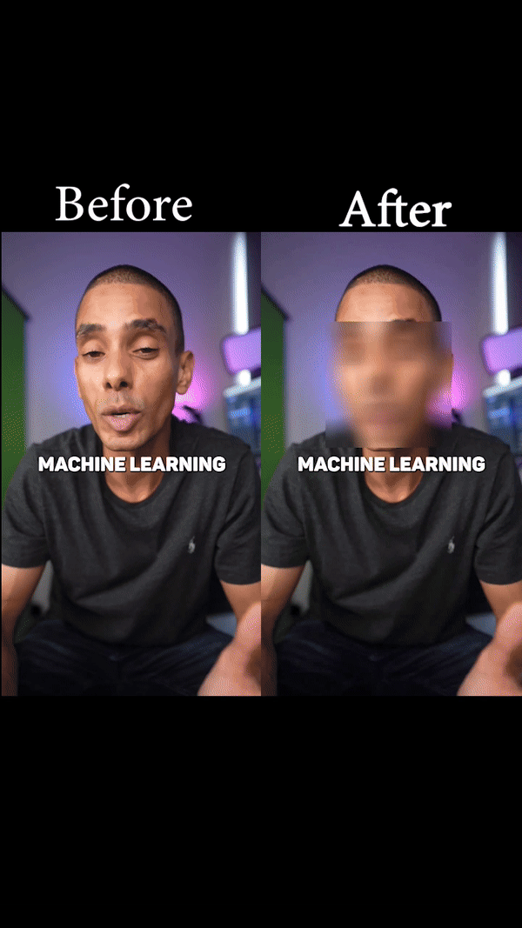
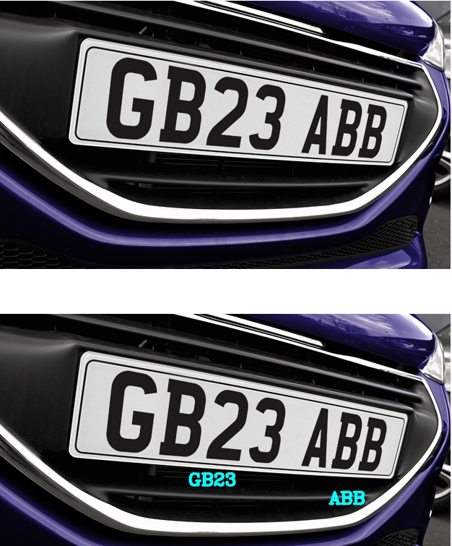
Next Lecture Projects
Face Detection and Blurring
Text Extraction

Slide 35
Thank You !!

